Slide 1


Proposals for new research: Feature representations for anomaly detection
Autoencoder,Spike2Vec,Hashing2vec, NLP
Notes:
Will show

Slide 2
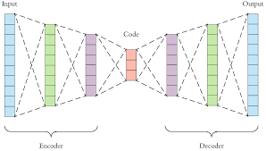


AUTOENCODER + ML
Autoencoders can be used for feature representation. There are some works in the literature demonstrating usefulness in feature representation.
MFV | MFL | MFP | MFC
1 | 0 | 0 | 0
0 | 1 | 1 | 0
0 | 1 | 1 | 0
From December 2019
– Febraury 2023
Probabilistic Random Forest
K nearest neighbour
OneClass SVM

Slide 3
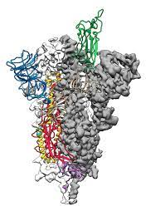
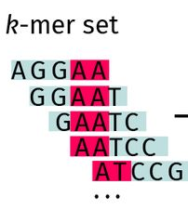
Spike2Vec
Compute all k-mers (k=3)
Convert the k-mers into a numerical representation. Therefore, we design a feature vector that contains the count of each k-mer in its respective spike sequence. The length of each frequency vector becomes 21^3 = 9261.
Use an approximate kernel method called random Fourier features (RFF), which maps the input data to a randomized low dimensional feature space (euclidean inner product space).
From December 2019
– Febraury 2023
New Rappresentations
AVAILABLE CODE

Slide 4
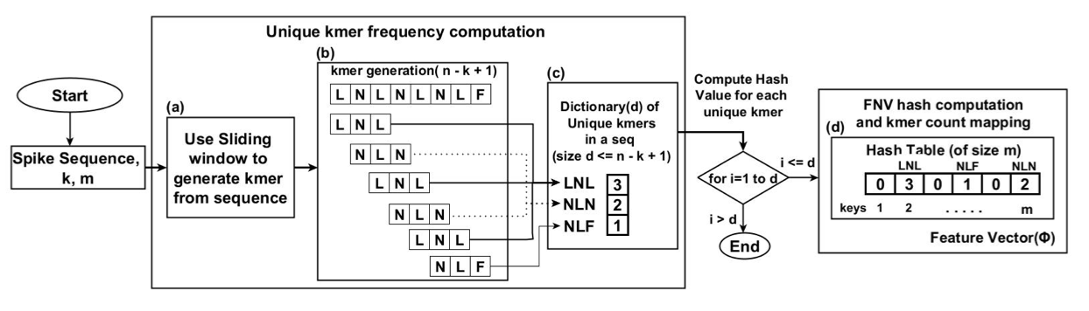
Hashing2Vec
1. The authors compute the unique k-mers frequency count for the spike sequence of length n (a,b,c); 2. Creation of dictionary d to keep the counts of unique k-mers in a spike sequence;
3. Each unique k-mers in the dictionary d is passed through the FVN hash function to get a corresponding hash value;
4. The k-mers frequency count from the dictionary is mapped to the hash table (d)
5. PCA (Principal Component Analysis)
AVAILABLE CODE

Slide 5
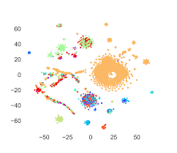

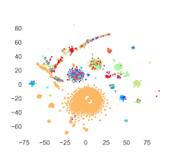
FEATURE REPRESENTATION + ML/DL
From December 2019
– Febraury 2023
Spike2Vec
Hashing2Vec

Slide 6
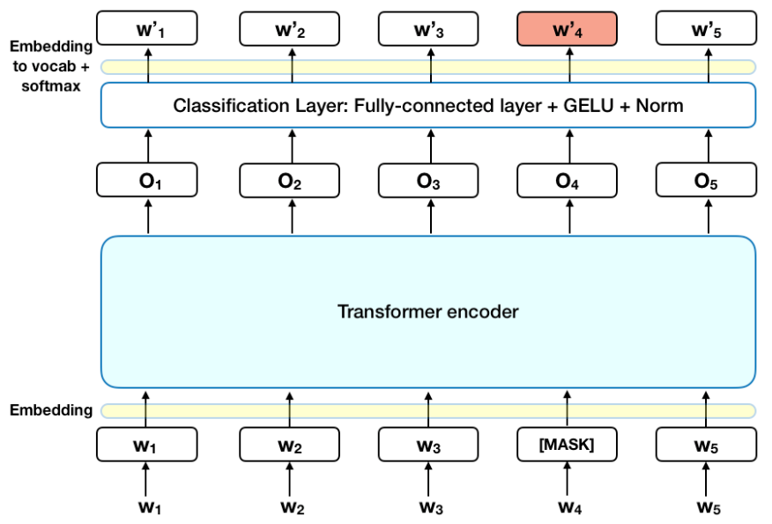
NLP
From December 2019
– Febraury 2023
1. Collaboration with Tommaso Buonocore (University of Pavia)

